Slide 1
Engineering seismology & Hazard analysis 2019
Tutorial 1
Signal processing
Onur Deniz Akan
IUSS PAVIA
o.akan@meees.org

Slide 2
What Signal? & Why?
Sound waves → High frequency, hearable range (20 Hz – 20,000 Hz)
Electricity → (50 Hz – 60 Hz)
Seismic Signals → (0.07 Hz to 50 Hz)
  Question #1: How would you measure the damage on a structure after a strong ground motion?
  Question #2: What does AvgSa(T) mean in the time domain physically?

Slide 3

Fourier Analysis
Time signals can be decomposed in to series of orthogonal cosine and sine functions with finite amplitudes and frequencies. The Fourier Analysis is the mathematical operation done for crossing between time and frequency domains. By taking the Fourier transform, a time signal can be transferred in to frequency space, interpreted, processed and reverted back to time domain without information loss.
Forward Fourier Transform
Inverse Fourier Transform
Recall! → Euler’s Identity:
$$e^{i2π}=cosπ+i sinπ$$

Slide 4
Fourier Analysis
Important Properties of the Fourier Transform:
Linearity:
Integration: →
Convolution:
Time Reversal:

Slide 5
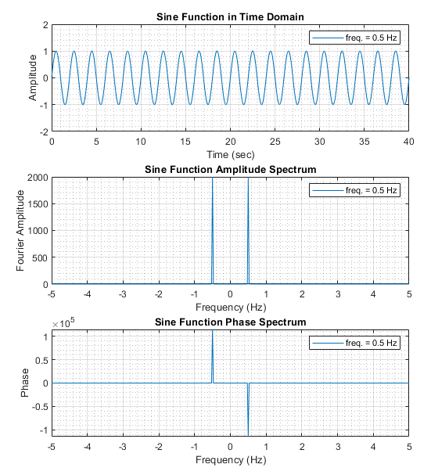
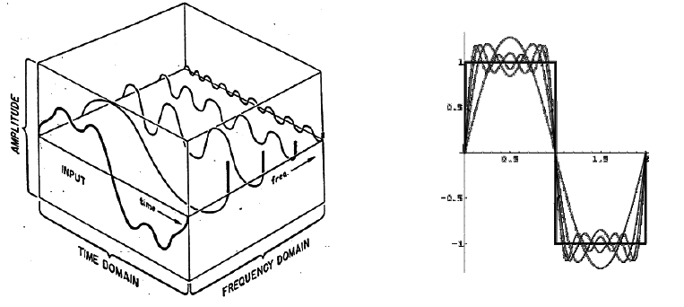
Frequency Domain

Slide 6
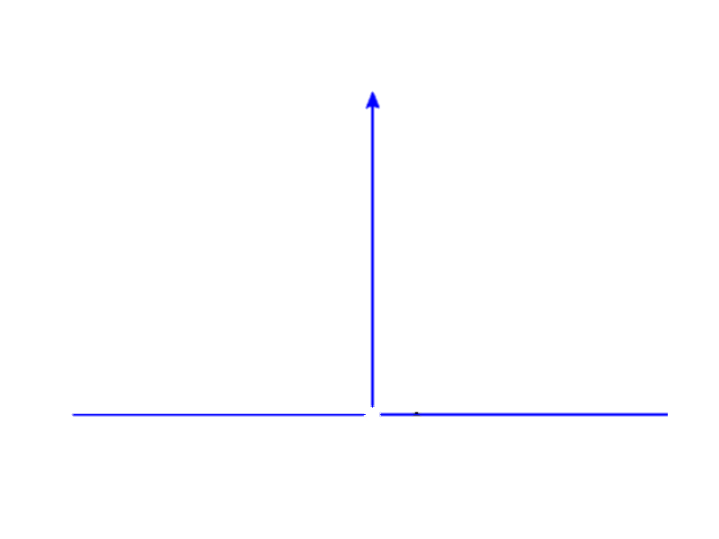
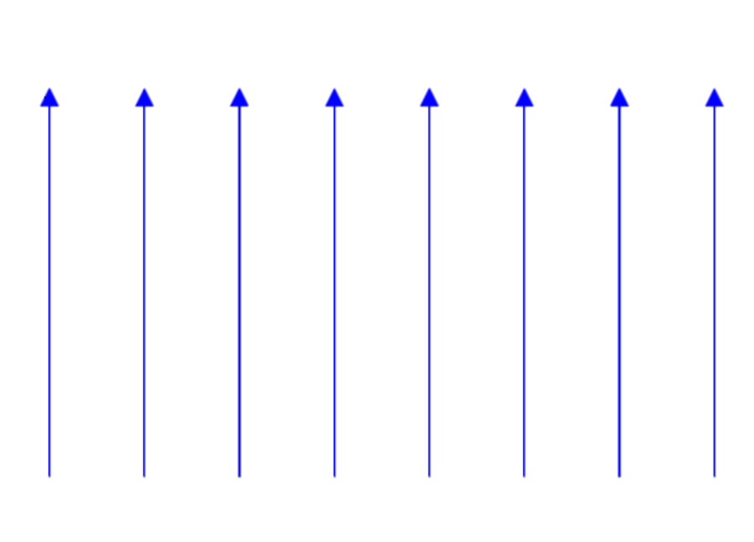
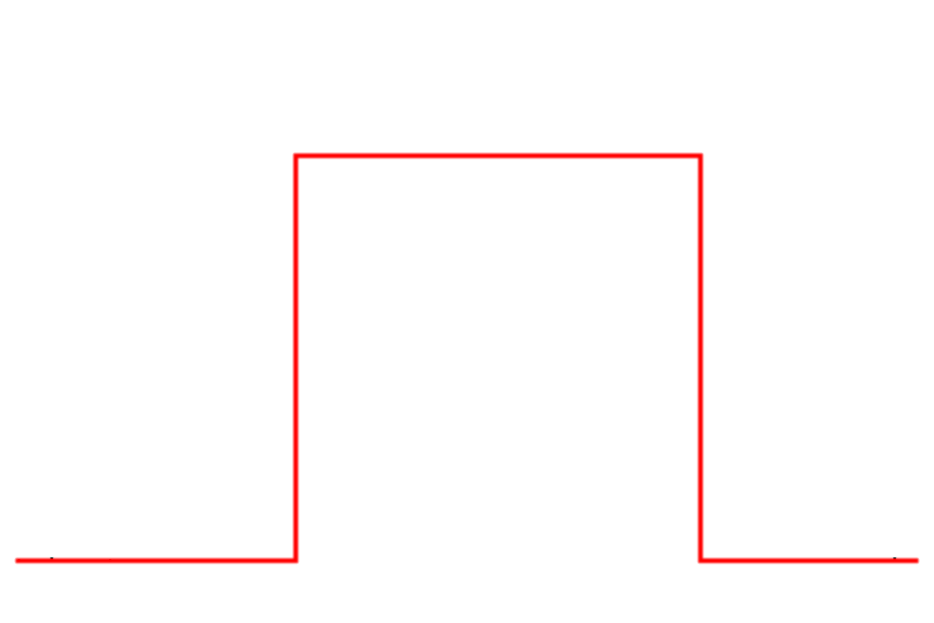
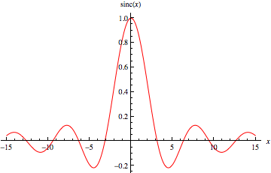
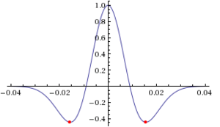
Useful Functions
Boxcar
Dirac (Delta)
Dirac Comb
Mexican Hat (Ricker Wavelet)
sinc(x)

Slide 7
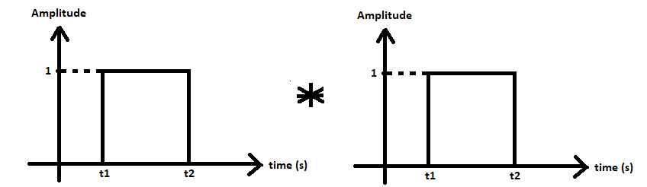
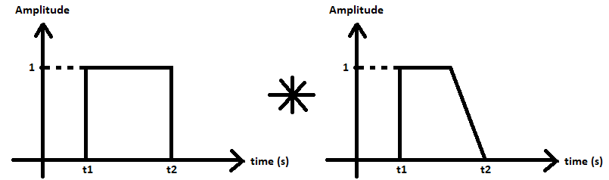
Convolution Example
Lets imagine the convolution of two boxcars…
Finally imagine a boxcar and an asymmetric function…

Slide 8
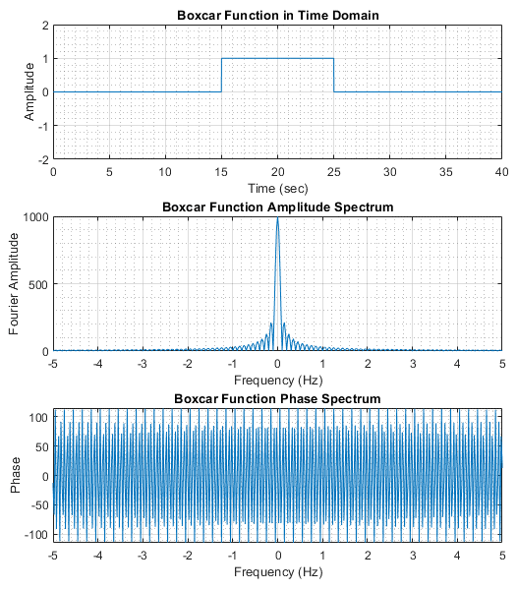
Gibb’s Phenomenon
Rectangular signals can only be approximated by adding infinite cosine and sine functions. Gibbs phenomenon occurs when a sharp change exists in the signal.
Gibb’s phenomenon is even more emphasized in filtering…

Slide 9
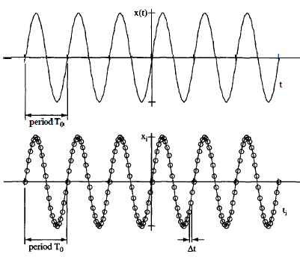
Discrete Signals
So far, we were considering continuous (analytical) signals which were completely defined over a finite or infinite time domain.
However, computers work with signals defined by discrete data points (also called as sample points taken from the continuous signal).

Slide 10
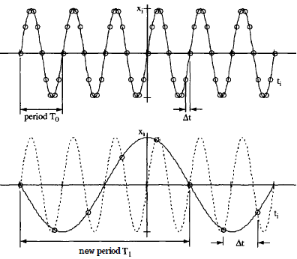


Nyquist Theorem
Nyquist theorem draws attention to a fundamental property of the discrete signals. It is only possible to properly identify the frequency of a discrete signal if the sampling frequency is higher than the Nyquist frequency.
Sampling Frequency
Nyquist Frequency
$$f_{samp.}=\frac{1}{∆t}$$
>
$$f_{nq.}=\frac{2}{T_{0}}$$
In practice: Minimum 10 points per cycle

Slide 11
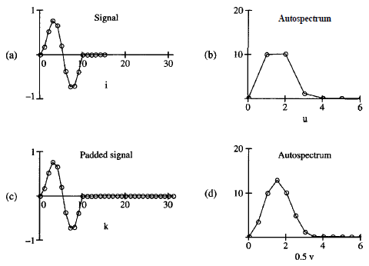

Padding
Frequency resolution of the signal is increased by increasing the signal duration. This is often done by adding zeros at the end of the signal.
Frequency Resolution:
$$∆_{f}=\frac{1}{∆_{t}∗N}$$

Slide 12
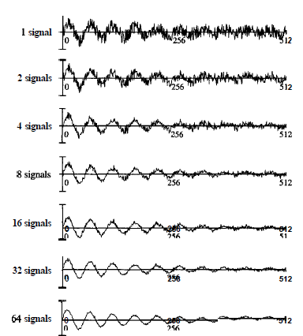
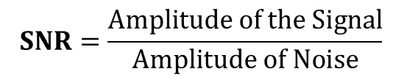
Noise
The high frequency distortion due to the environmental affects in the signal is often considered as noise.
Signal to Noise Ratio (SNR)
Repeating the recording several and stacking them together is a way to increase SNR.
$$SNR=\frac{Amplitude of the Signal}{Amplitude of Noise}$$

Slide 13
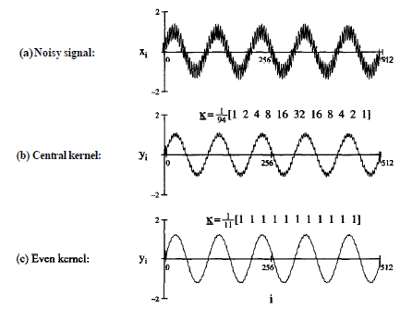
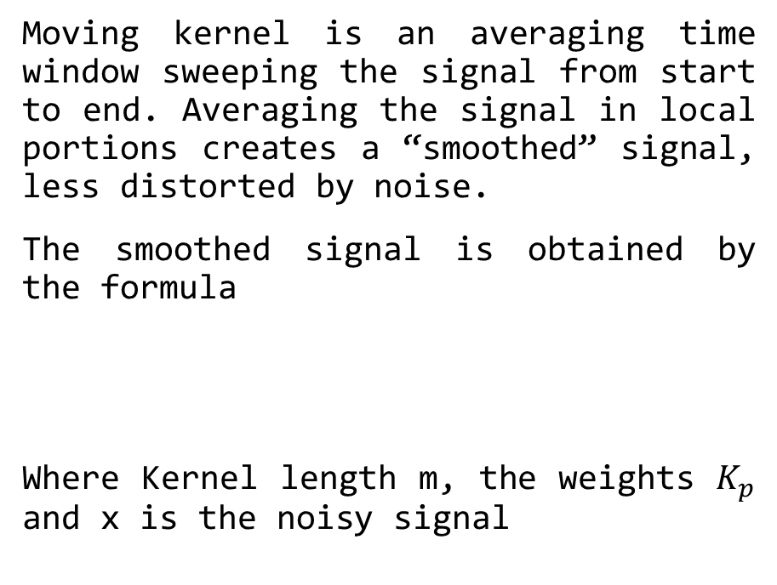
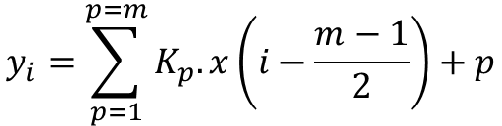
Moving Kernels
Moving kernel is an averaging time window sweeping the signal from start to end. Averaging the signal in local portions creates a “smoothed” signal, less distorted by noise.
The smoothed signal is obtained by the formula
Where Kernel length m, the weights $K_{p}$ and x is the noisy signal
$$y_{i}=\sum_{p=1}^{p=m}{K_{p}.x\left(i−\frac{m−1}{2}\right)+p}$$

Slide 14
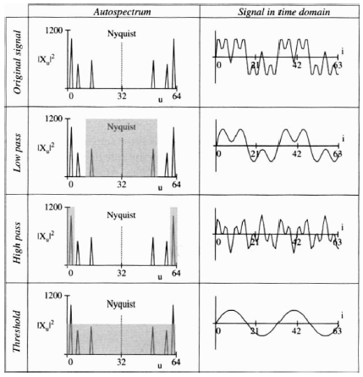
Filtering
In frequency domain, a filter is a window that is passing a band of frequency and blocking the rest. Filters are applied as a point by point multiplication with the amplitude and phase spectrum of the original signal.
Low Pass: Passes only the frequencies lower than the filter frequency.
High Pass: Passes only the frequencies higher than the filter frequency.
Band Pass: Passes only the frequencies in between the high and low frequency limits that are bounded by the filter.

Slide 15

Ringing Artefact

Slide 16
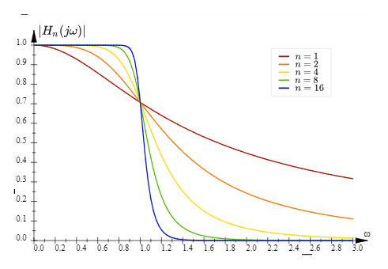
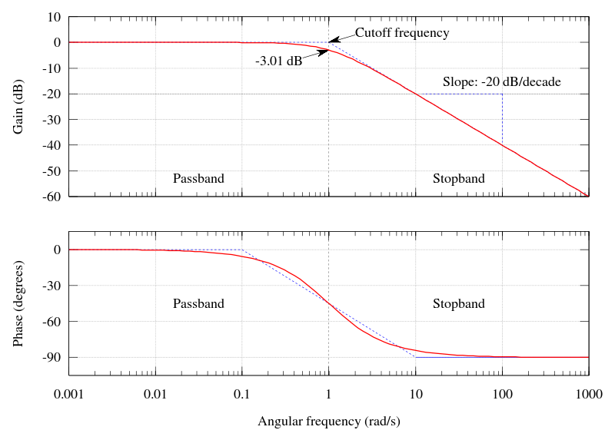
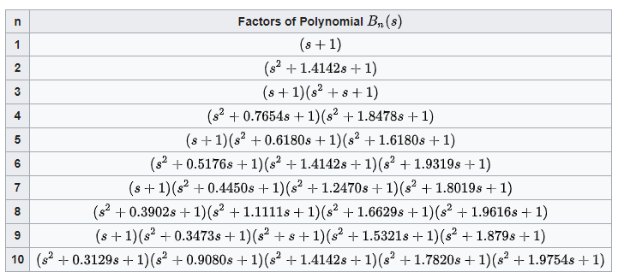
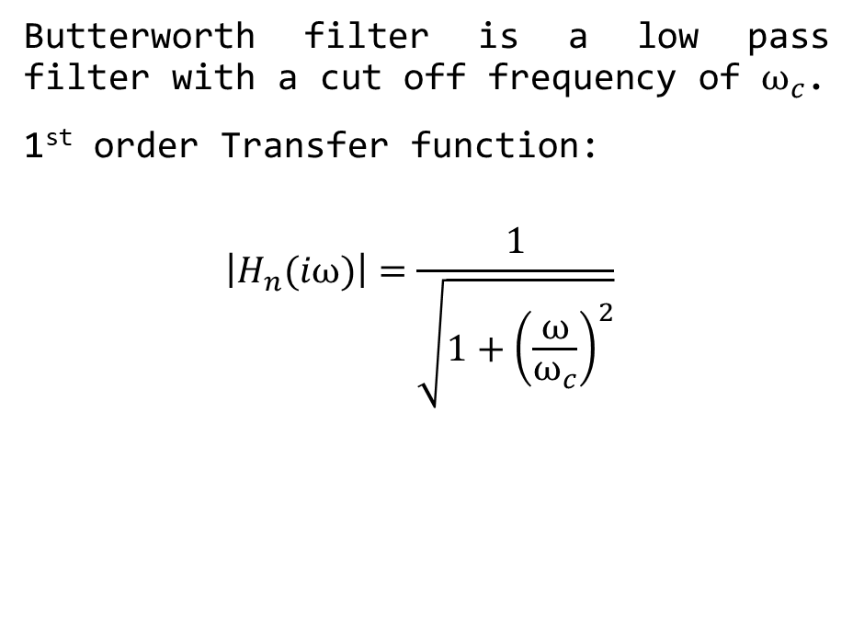
Butterworth Filter
Butterworth filter is a low pass filter with a cut off frequency of $ω_{c}$.
1st order Transfer function:
$$\left|H_{n}(iω)\right|=\frac{1}{\sqrt{1+{\left(\frac{ω}{ω_{c}}\right)}^{2}}}$$
← Pyramid of truth!

Slide 17
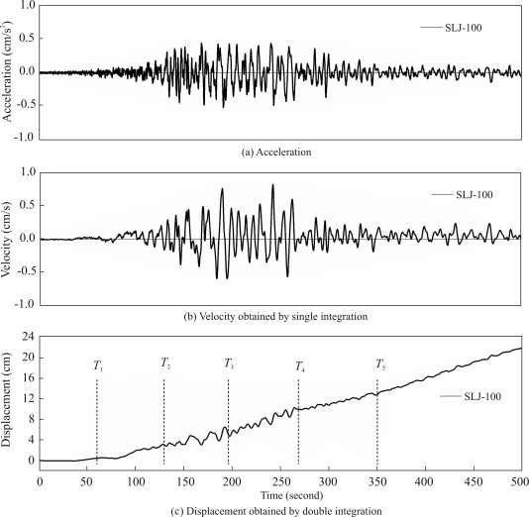
Baseline Correction
Baseline correction is needed when the signal is off the axis. Whether this is due to the instrument or the data, an upward shifted horizontal axis with a constant, may introduce significant errors especially after integration.
To remove the baseline, the mean of the signal is computed along the time domain and a linear/quadratic function is fitted. Then the fitted function is subtracted from the amplitude of the original signal.

Slide 18
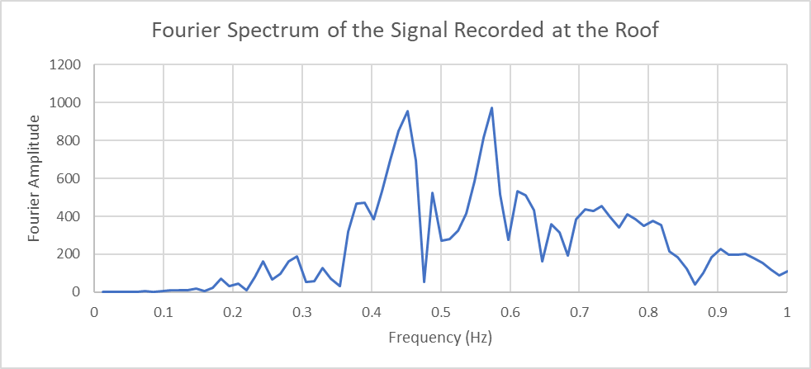
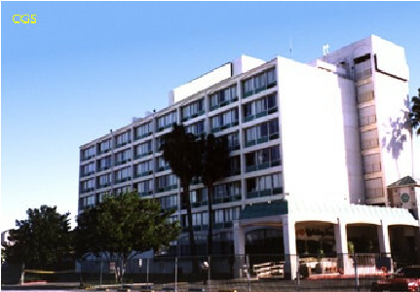
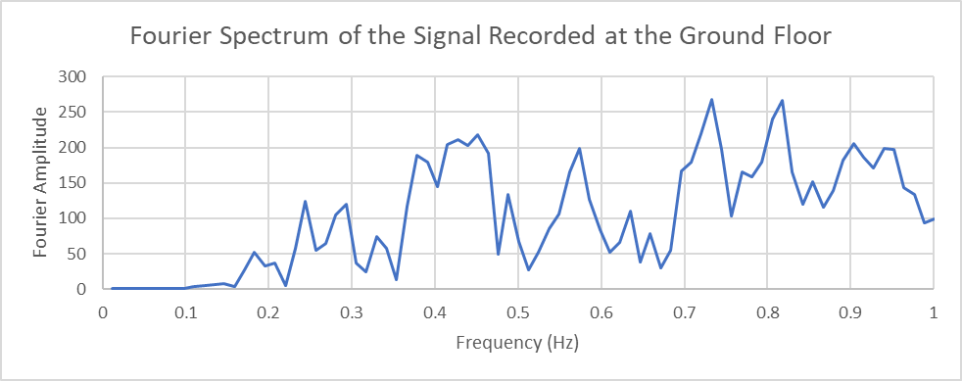
Van Nuys Building
PEER Testbed, 7 Storey Hotel in Van Nuys, California

Slide 19
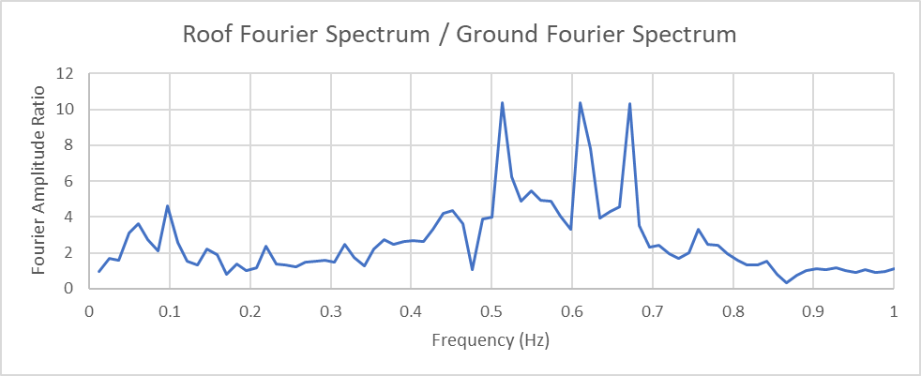
Van Nuys Building
Transfer Function →
Used of the in structural health monitoring!

Slide 20
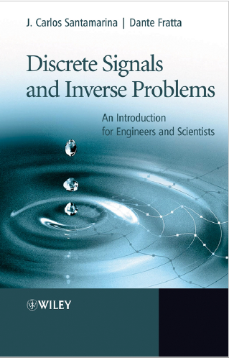
Further Reading
Also as a reference for this tutorial notes:
Santamarina, J.C. & Fratta, D. (2005) Discrete Signals and Inverse Problems. An Introduction for Engineers and Scientists. Published by John Wiley & Sons, Ltd, West Sussex, England

