Slide 1
Introduction to
Seismic Hazard Analysis
Valerio Poggi
Global Earthquake Model (GEM), Pavia Italy
Addis Ababa, 29 June 2016

Slide 2
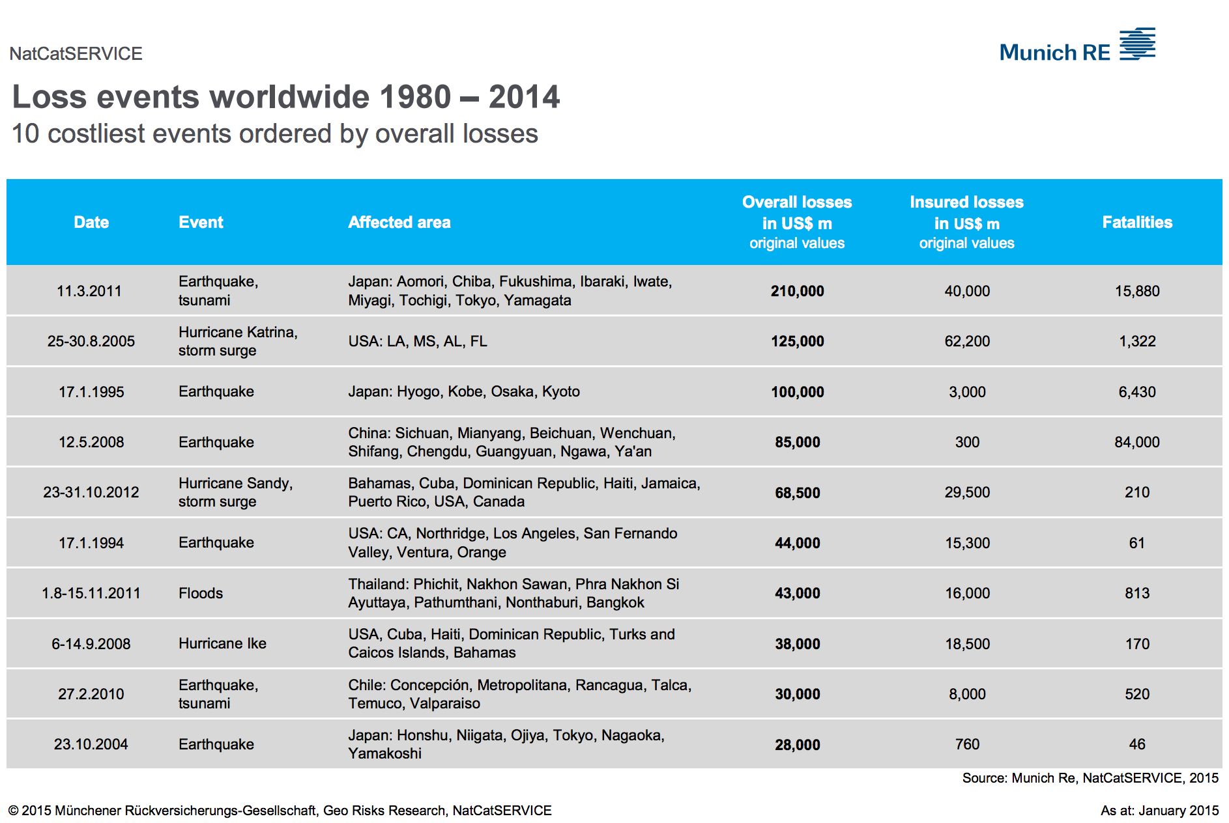
Earthquake Hazard – A widespread danger
Earthquakes are one of the most costly natural hazards worldwide
2

Slide 3
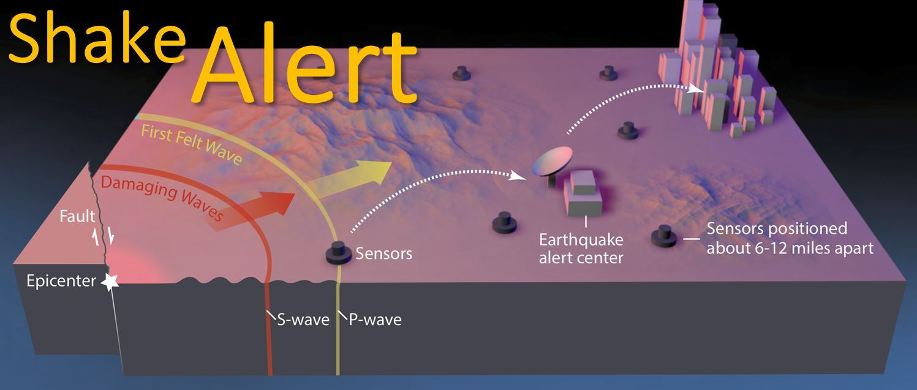
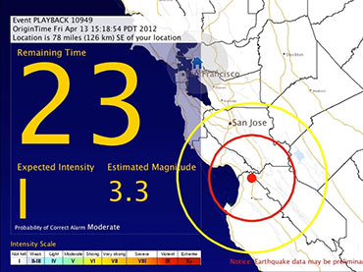
Earthquake Hazard – Forecasting
Reduction of fatalities could ideally be carried out through short-term forecasting with:
Analysis of precursors (highly debatable)
Early warning systems (large investment, practical limitations)
USGS ShakeAlert
EEW Program

Slide 4
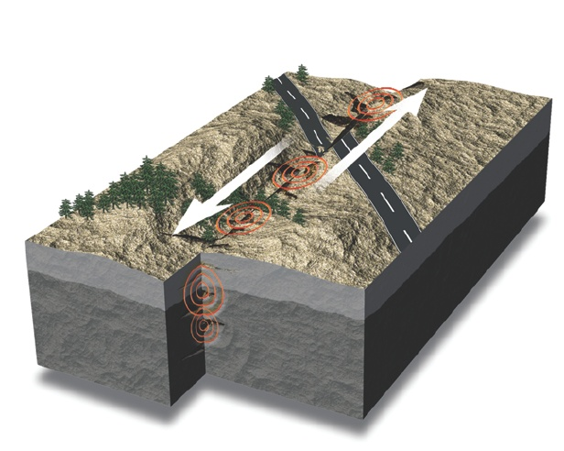
Earthquake Hazard – Ground Shaking Level
Reduction of losses should be properly done by preemptive design and reinforcement of new and existing building and infrastructures
This requires, however, a proper estimation of the ground shaking level likely expected at a site within a given interval of time
Question is: how and how precisely this level can be defined, given the little knowledge we have of the earthquake process?
This is the task of
Seismic Hazard Analysis (SHA)….
http://www.howitworksdaily.com/

Slide 5
Earthquake Hazard and Risk
EARTHQUAKE RUPTURE
Seismic Hazard is therefore an essential component of Earthquake Risk Assessment
SEISMIC WAVES
SURFACE GEOLOGY EFFECTS
R = H * E * V
SOIL-STRUCTURE INTERACTION
Seismic Hazard (H)
EFFECTS ON STRUCTURES
Physical Vulnerability (V)
Exposure/Inventory (E)
LOSS ASSESSMENT
Risk (R)

Slide 6
End-Users Perspective
1) Engineers
For what level of ground motion should I design my structure?
What are the possible earthquake scenarios that may pose a threat to my structure?
The Building Standard says I should ensure this performance level – how do I know how resistant to make my structure to ensure this?
What if I want to achieve different performance objectives (e.g. “operational”, “life-safety”, “no-collapse”)?
2) Insurers
What is the probability of my exceeding X amount of loss from my portfolio in the next T years?
The Catastrophe Bond will trigger when “… earthquake occurs in this cell … ground shaking exceed this value here…” – how likely is this to happen?
3) Decision Makers & Public
Will this property be damaged/destroyed?
How likely is this to happen?
What is the best course of action to take (cost-benefit)?
What sort of earthquakes can occur? What might happen when they do?

Slide 7
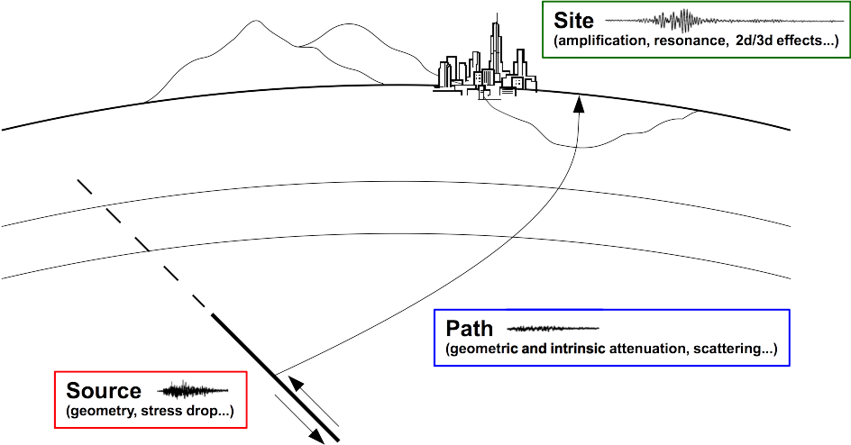
SHA Requirements
For the calculation of hazard associated to a region is essential to know:
Where the earthquakes occur and the geometry of the seismic sources
How often earthquakes occur on each seismic source
The size of the earthquakes generated by each source
Mechanical properties of geological materials through which seismic waves will propagate (including surface geology)

Slide 8
Deterministic vs. Probabilistic Approach
Two are the main methodologies currently adopted for seismic hazard analysis:
Deterministic. Also called the “Worst Case Scenario”
One or a few earthquake scenarios are selected and the corresponding ground motion computed assuming a level of uncertainty on ground motion (i.e. a number of standard deviations above the median value predicted by a Ground Motion Prediction Equation - GMPE).
Probabilistic: All possible scenarios of engineering relevance for the investigated site are considered in the analysis taking into account their probability of occurrence i.e. all ruptures (magnitude+distance) and levels of uncertainty on ground motion.

Slide 9
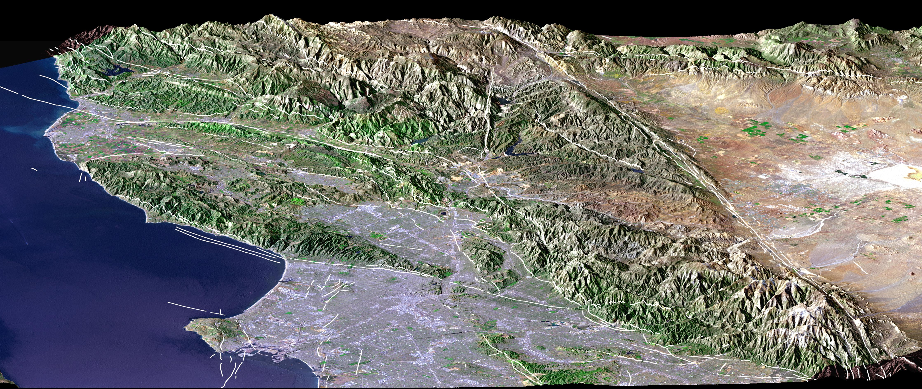
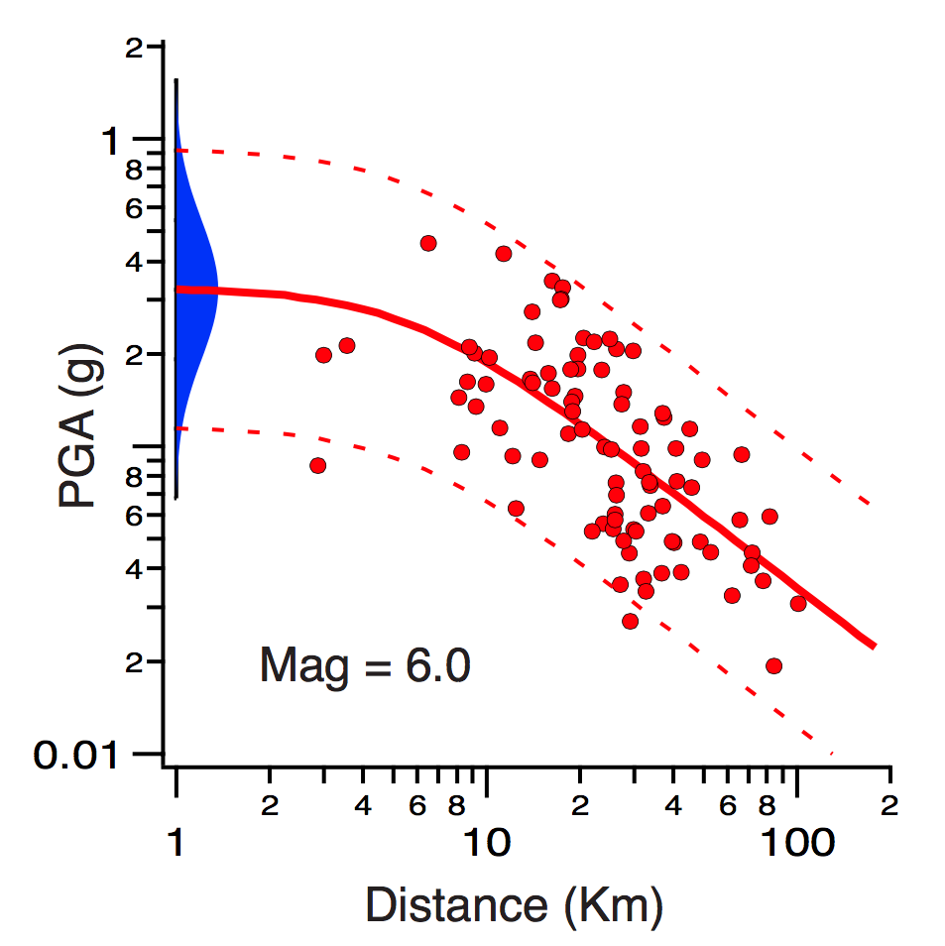
Deterministic Approach – Defining the “worst case”
Scenario #1
http://eoimages.gsfc.nasa.gov
Many issues:
Largest earthquake in the source?
Closest earthquake to source?
Worst possible or plausible scenario?
M^{max}
R^{min}
Modified from Field (USGS)
PGA @ 20Km + σ
GMPE or Simulation

Slide 10
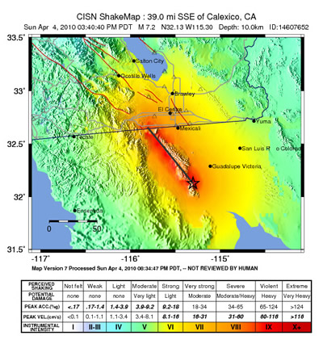
Scenario Models - ShakeMap Example

Slide 11
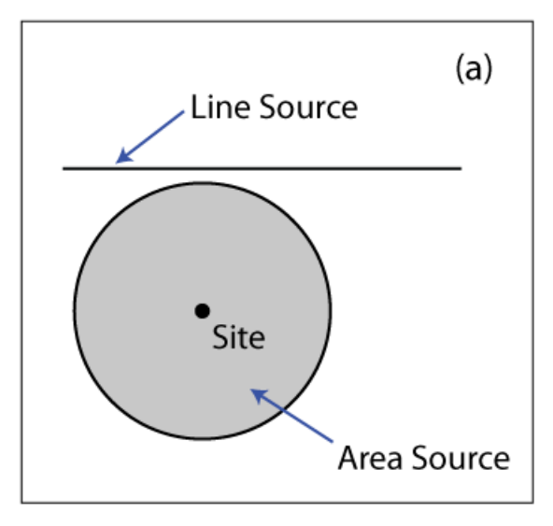
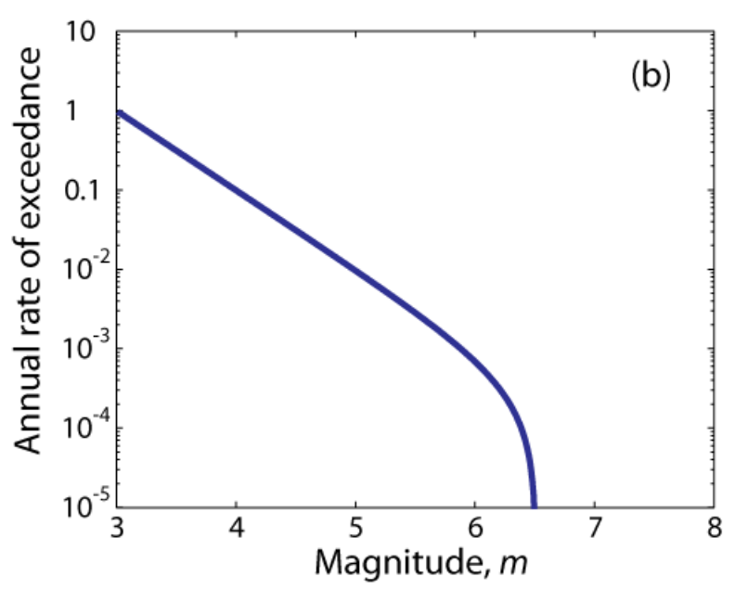
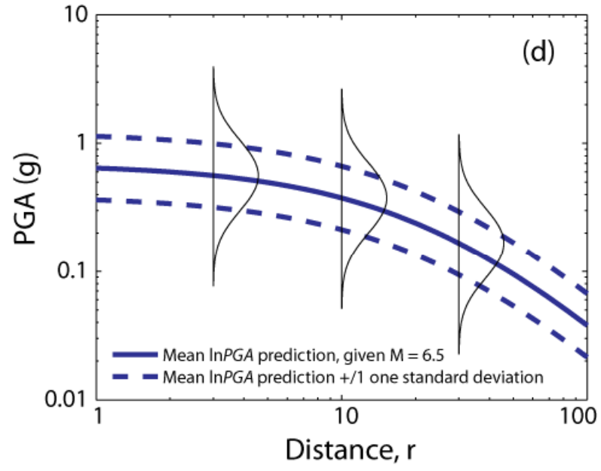
PSHA - Basic Workflow
Probabilistic hazard is computed by taking into account all the possible scenarios generated by all the sources within a certain distance from the investigated site
Where
Seismogenic Zone Models
When (how often)
Recurrence Models
How
Ground Motion Models
Modified from Baker (2008)

Slide 12
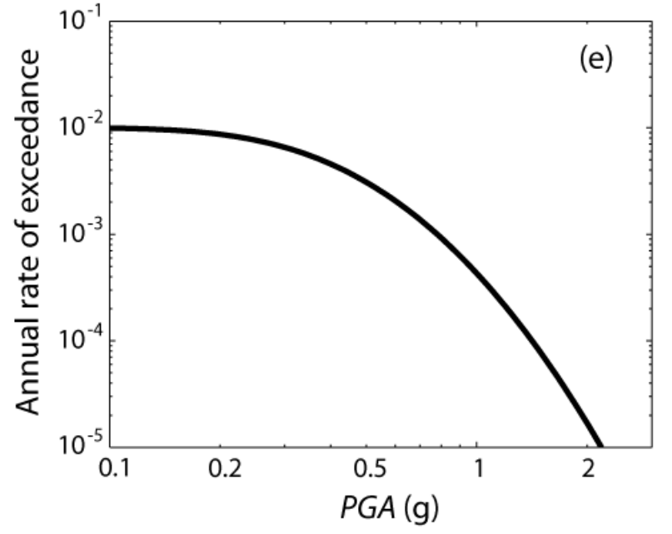
PSHA – Basic Equation
The rate λ of events with intensity (IM) larger than a value x experienced at a given site from the contribution of all sources can be formalized as:
Loop over distances
Loop over magnitudes
Loop over sources
The annual rate λ is then translated into probability by assuming a Poisson recurrence model (independent events):

Slide 13
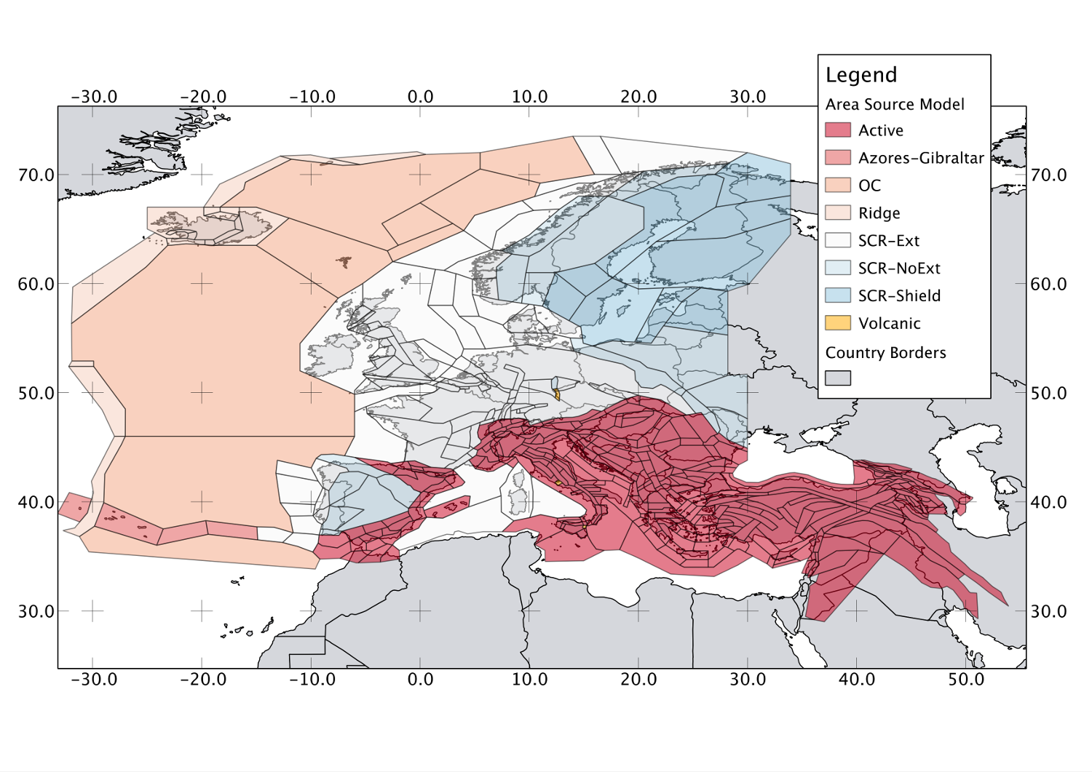
Seismogenic Zones
Distributed Seismicity:
Single points
Grid representations (e.g. smoothed seismicity)
Polygon of Uniform Seismicity (so far the most widely used approach)
SHARE Area Source Zonation Model

Slide 14
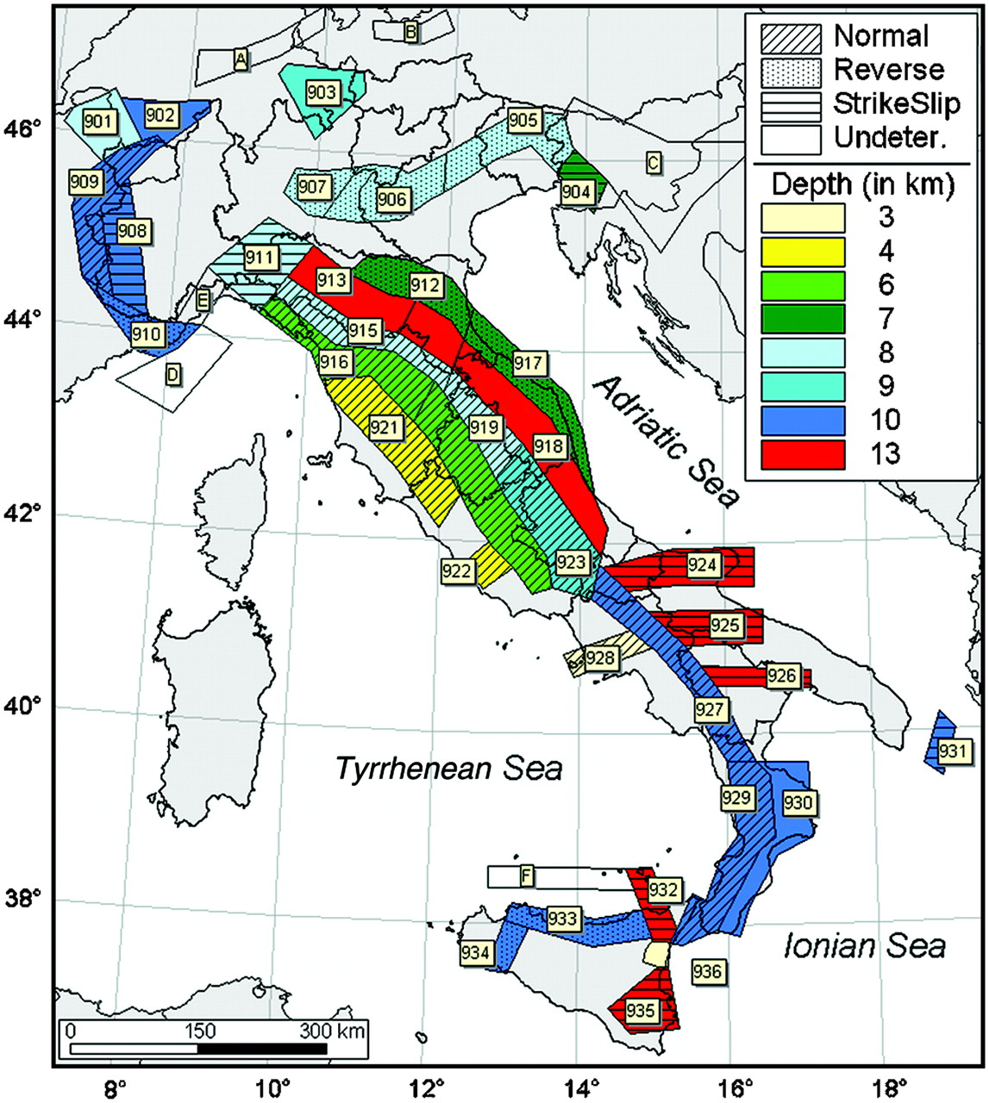
Area Sources Zones
Source Zone 1
Uniform Area Source Model of Italy
(modified from Meletti et al., 2008)
A(r)
Site
r
A^{tot}
The cumulative probability P(R < r) can be seen as the area of the sub-zone within a distance r from the site, divided by the area of the total source zone

Slide 15
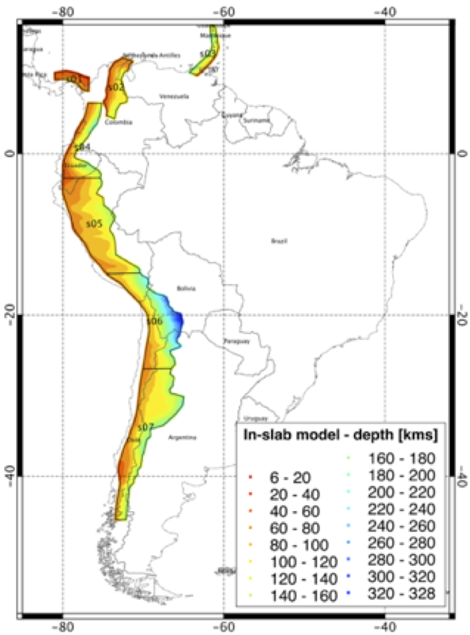
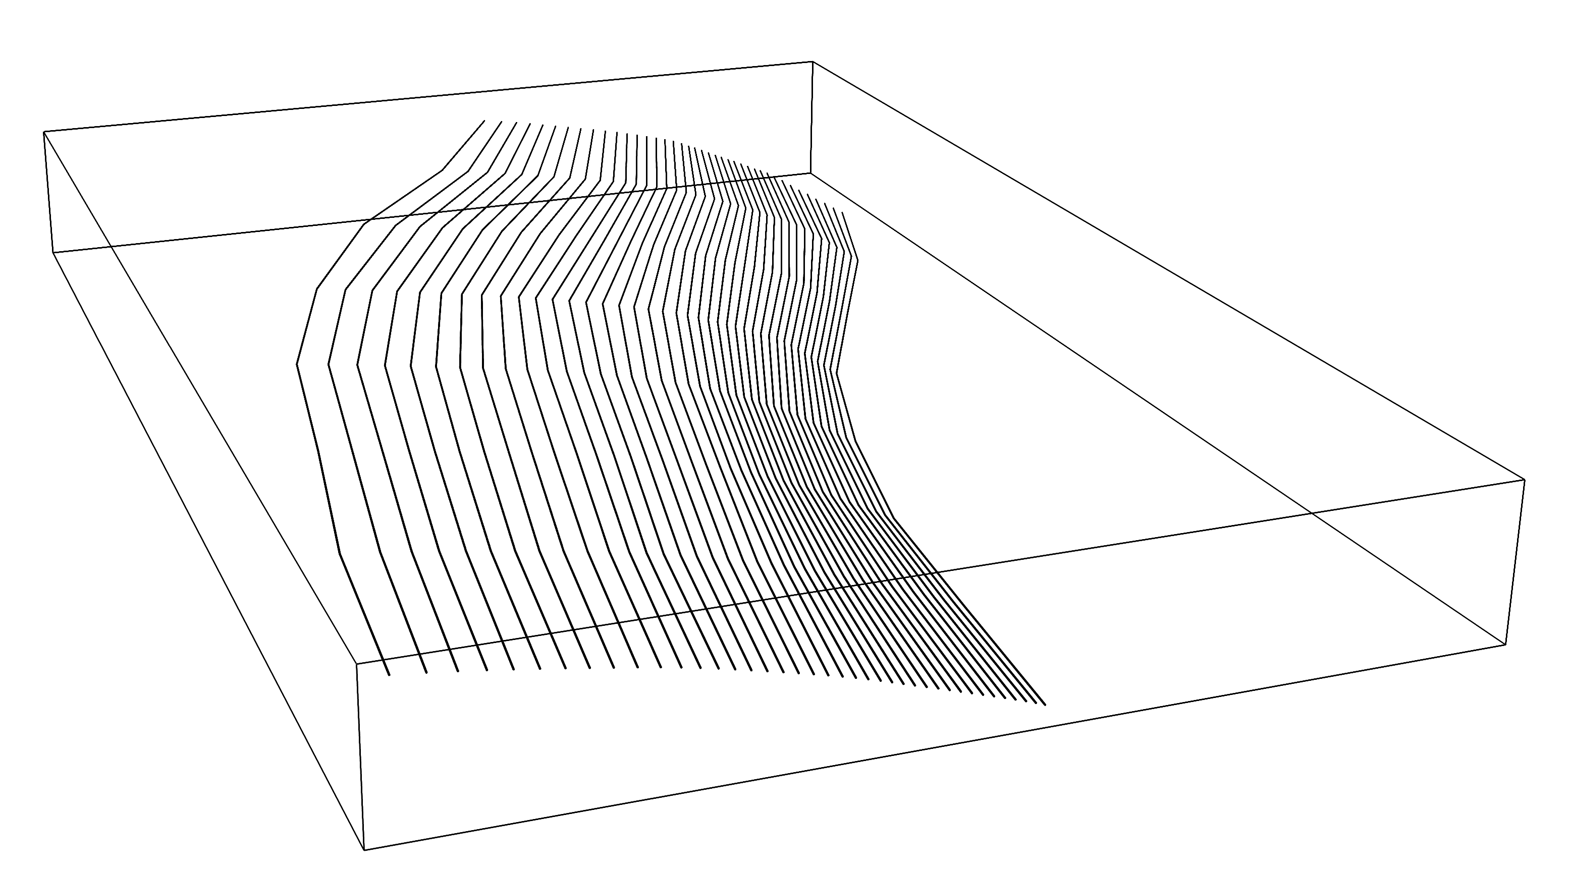
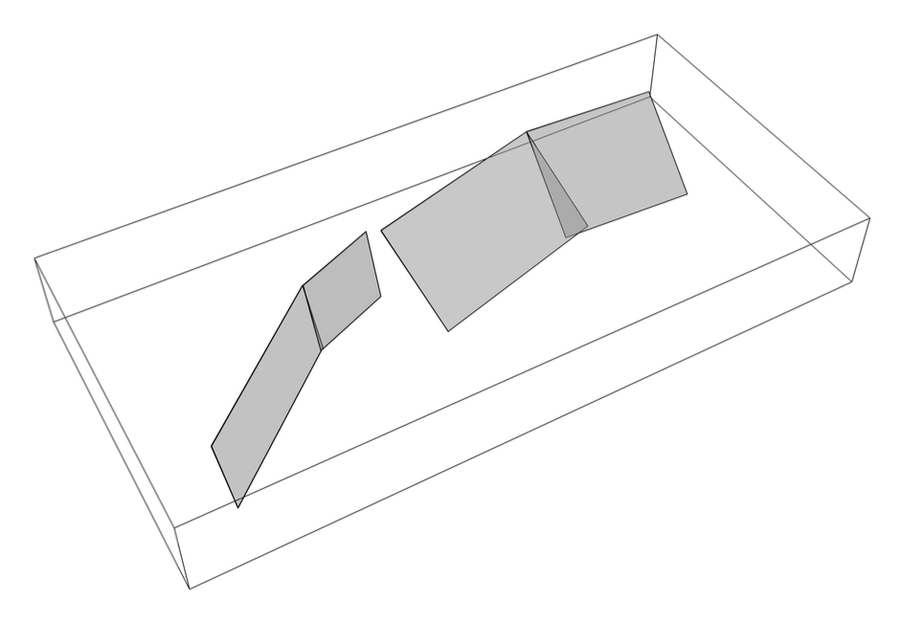
Active Faults
If fault geometry is sufficiently known, it can be modeled as a three-dimensional surface
Such approach can be used for active shallow faults as well as larger subduction interfaces
SARA Model
Complex fault
Segmented
planar fault

Slide 16
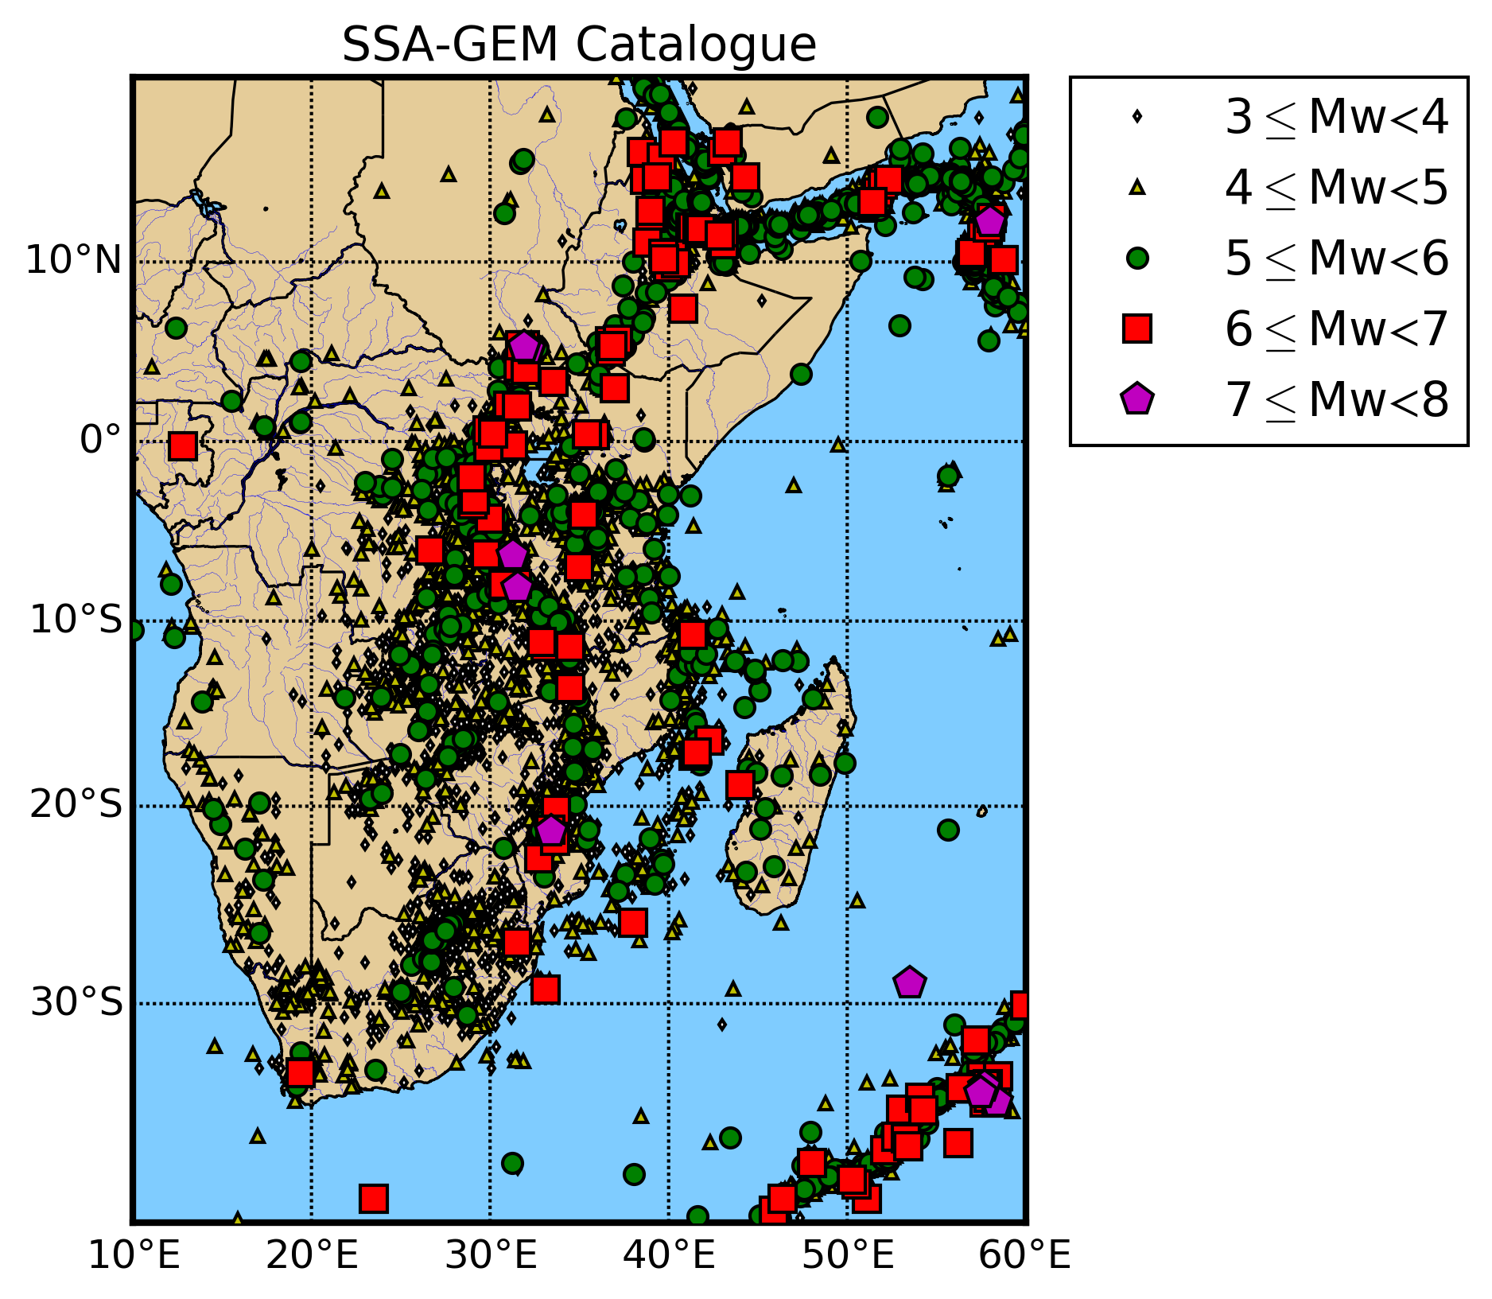
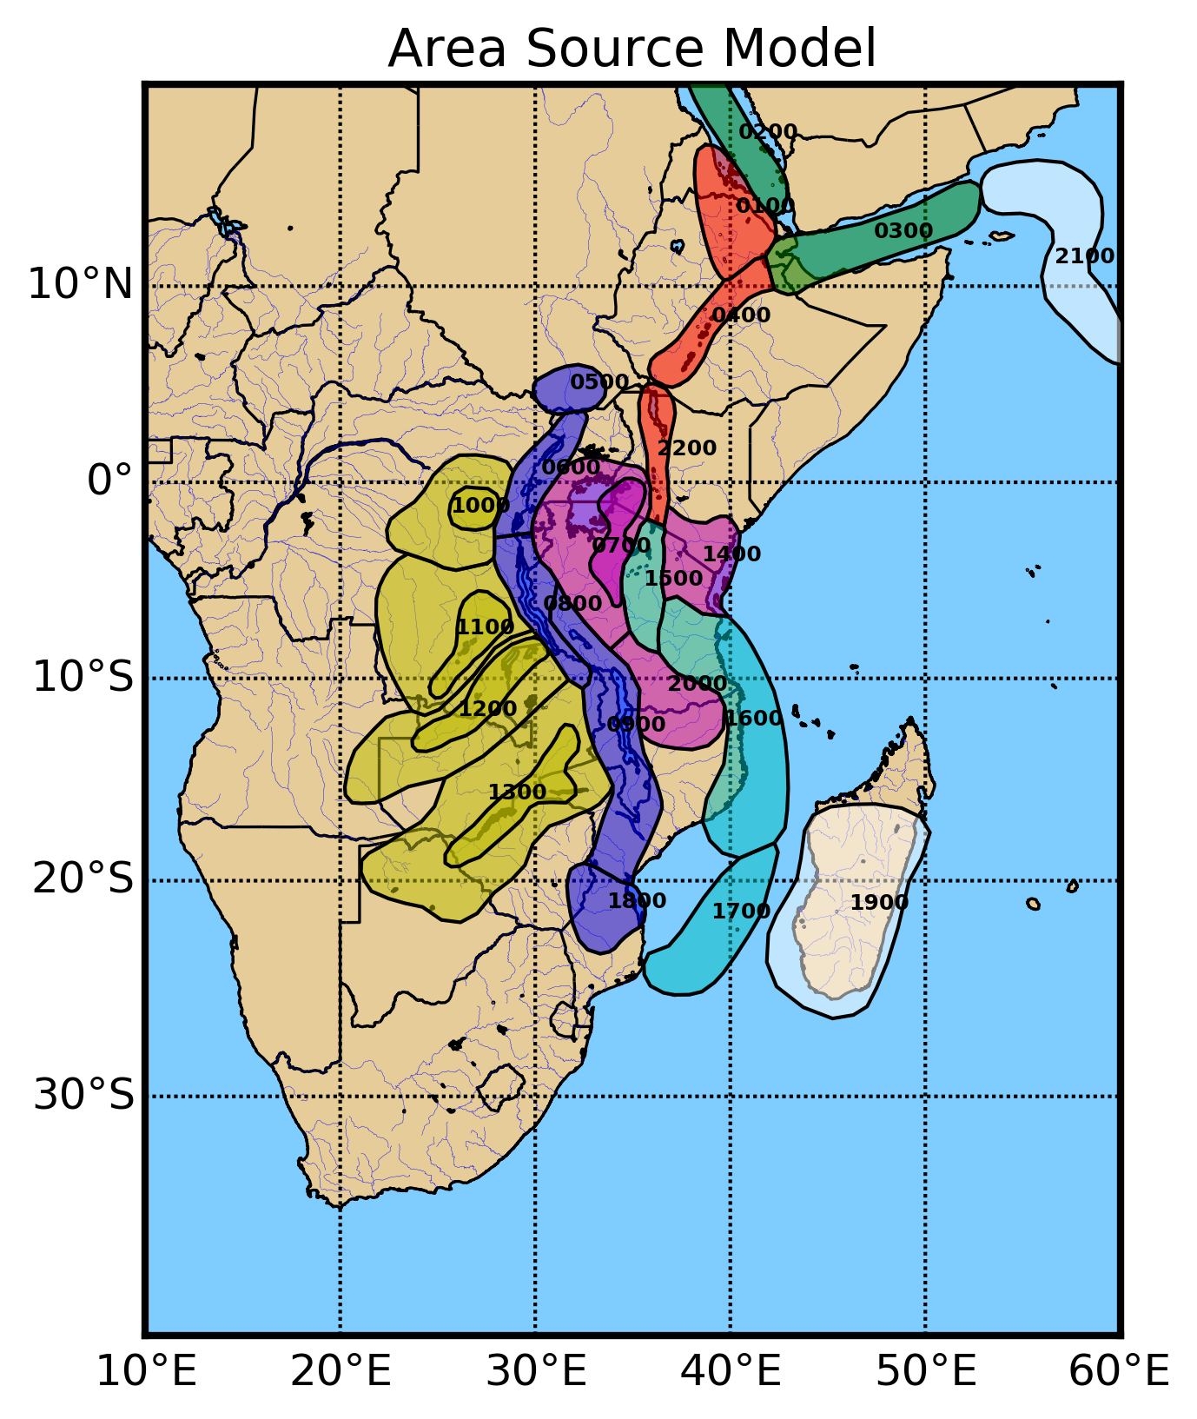
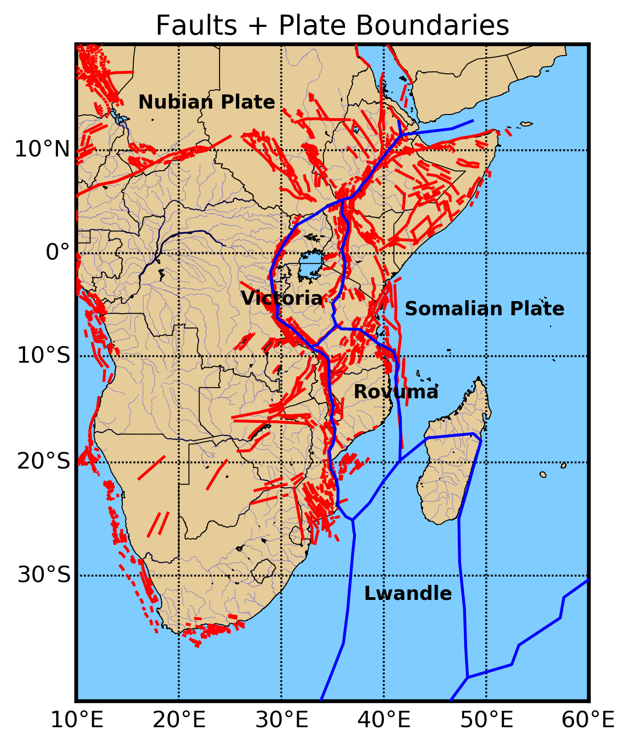
Building a Seismic Source Model
Primary data resource is the homogenized earthquake catalogue
Models of recurrence often determined from observed (instrumental and historical seismicity) within the source
Macgregor (2015)
Saria et al. (2014)

Slide 17
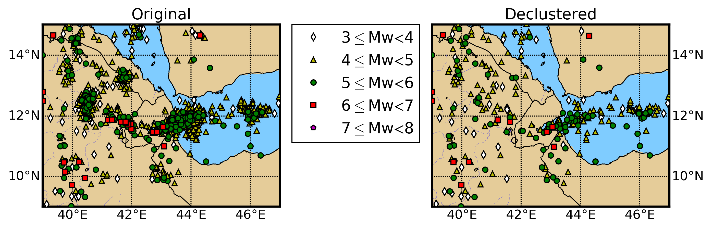
Seismicity Analysis
To obtain estimates of stationary seismicity rates the recurrence models need to be fit to earthquake catalogues that are:
Purged of non-Poissonian Events (i.e. foreshocks and aftershocks) which are dependent ➔ Declustering

Slide 18
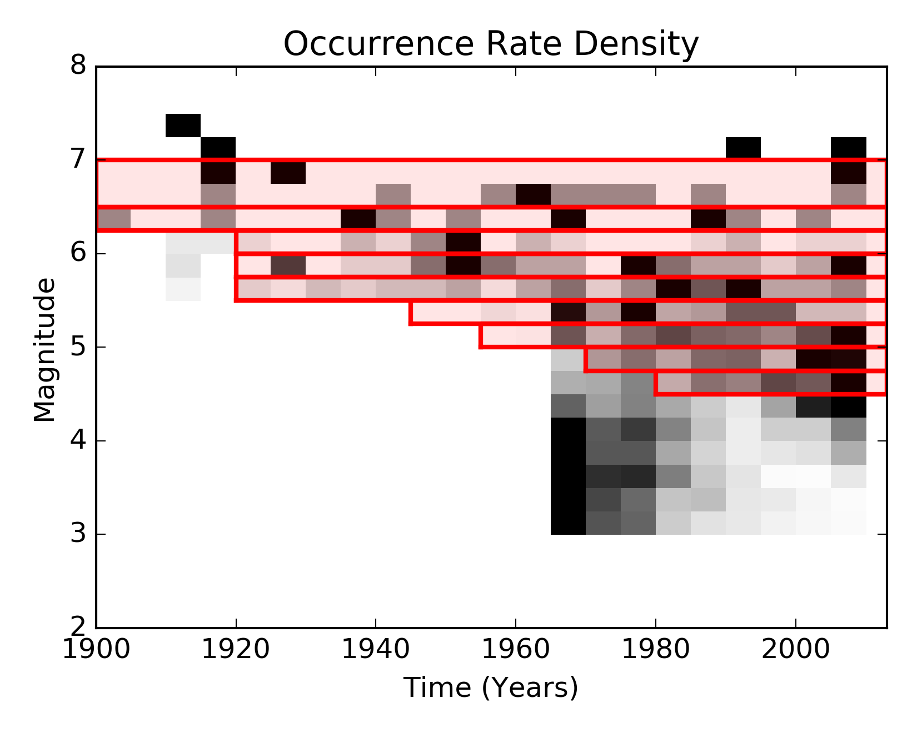
Seismicity Analysis
2) Spatially and temporally complete (i.e. are recording all events above a given magnitude for a particular space-time window)
➔ Completeness Analysis
Magnitude of completeness varies as function of time
Incomplete
Data Record
← M_{c}

Slide 19
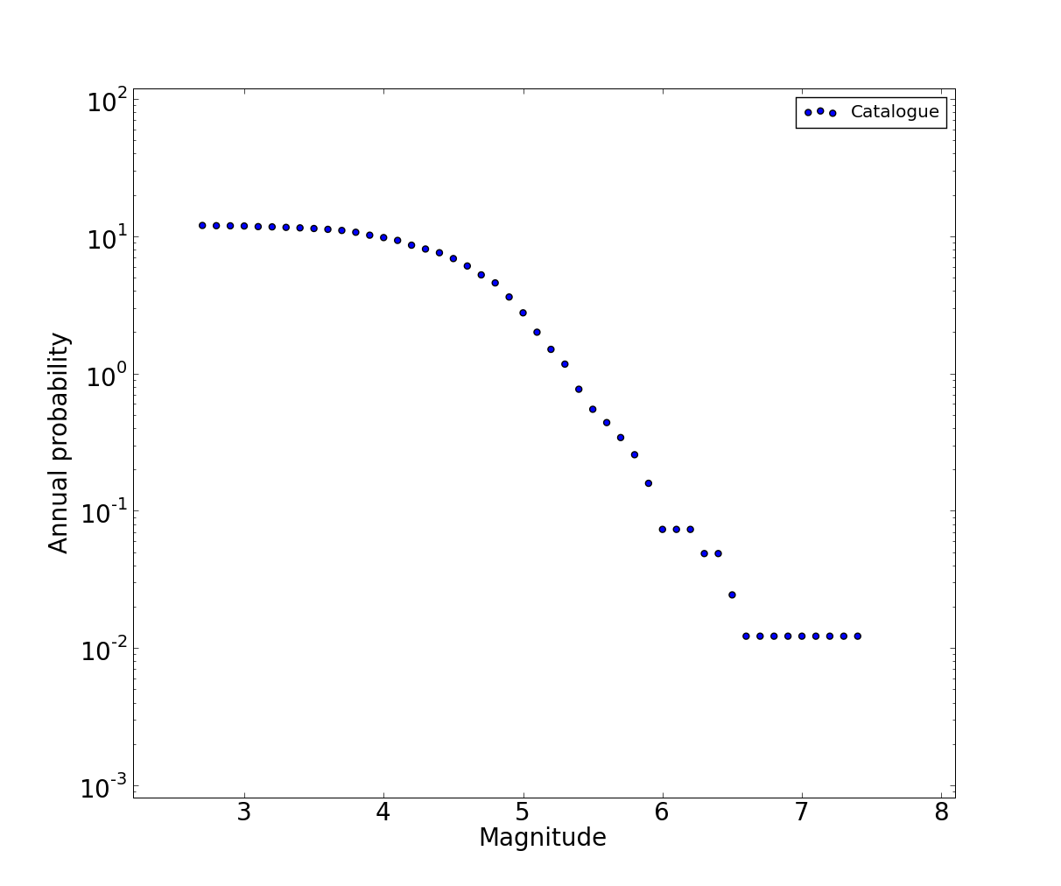
Magnitude occurrence relations
Temporal distribution of seismicity is modeled assuming a given magnitude occurrence relation
The most widely used relation is the Gutenberg-Richter exponential law:
Calibration of coefficients a and b is a key issue in PSHA
5.23 earthquakes above magnitude 4.8 per year
Complete above magnitude 4.8
GR occurrence relationship
M^{max}
Recurrence models typically fit to catalogue using maximum likelihood techniques

Slide 20
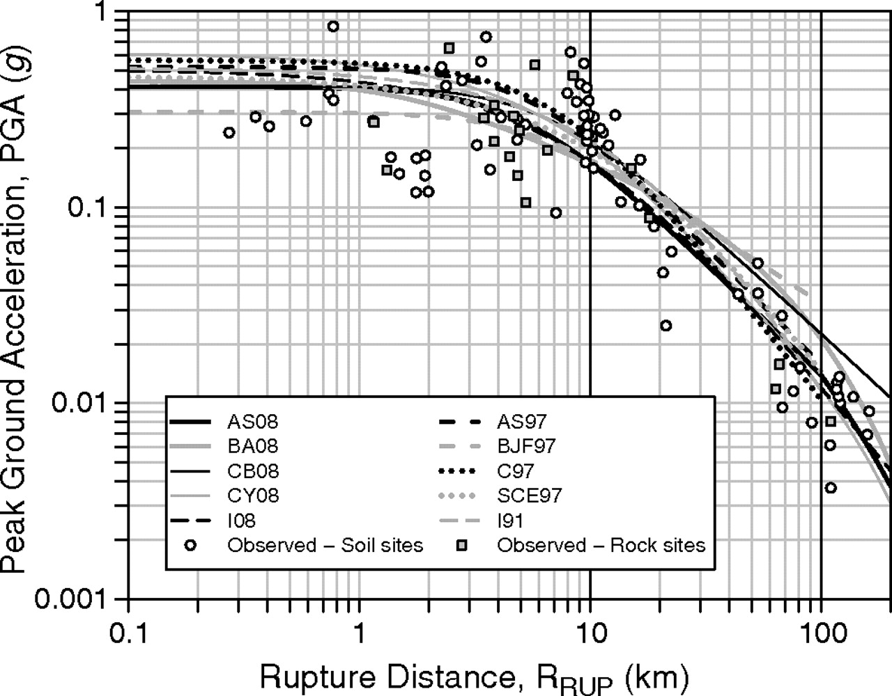

Ground Motion Modeling
The easiest way to model ground motion is perhaps the use of Ground Motion Prediction Equations (GMPEs)
GMPE terms are representations of a given physical model, whose reliability can be increased with the availability of new empirical information

Slide 21
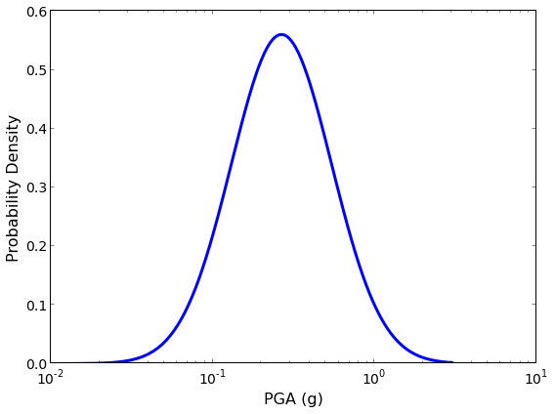
Ground Motion Prediction
A fundamental property of GMPEs is the assumption that the aleatory variability can be represented by a lognormal distribution characterized by a median ground motion and the corresponding standard deviation
Mw = 6.5
R = 20 km
P(IM > x | M, R) can then be easily determined as the probability that IM will exceed the value x
PGA = x

Slide 22

Variability and Uncertainty
Uncertainty and variability are concepts tightly linked with seismic hazard analysis
Two are the typologies of uncertainty considered:
Aleatory
Epistemic
Aleatory uncertainty is connected with the intrinsic randomness and the nature of the earthquake process
Epistemic uncertainty on the contrary depends on our limited knowledge the phenomenon (e.g. lack of observation data)
This means that: aleatory uncertainty is irreducible whereas epistemic uncertainty can be potentially reduced

Slide 23
Variability and Uncertainty
Epistemic and aleatory variability are nonetheless handled separately into the hazard analysis process:
1) Aleatory uncertainty is usually incorporated in the PSHA integrals
Examples: Earthquake location, uncertainty on ground motion estimates
2) Epistemic uncertainty is formally taken into account by using alternative models (or parameterizations) within a logic-tree structure
Examples: ground motion models, recurrence parameters (b-value, maximum magnitude), style of faulting….

Slide 24
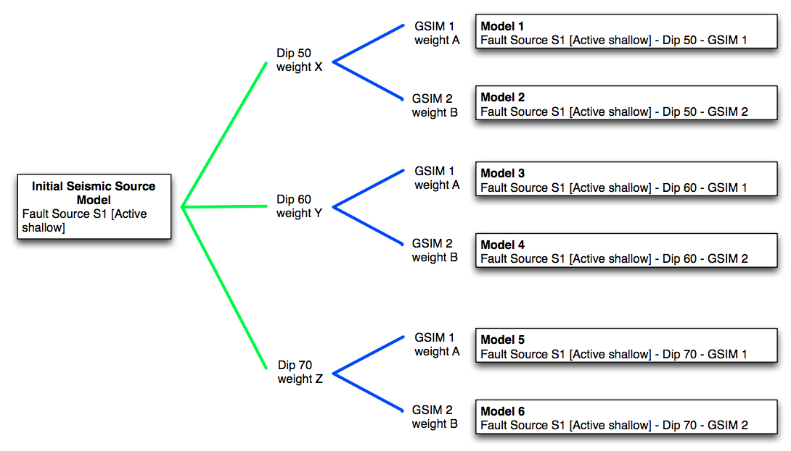
Logic- Tree Strategy – Weights and Branches
Epistemic uncertainties modeled by including multiple models in logic trees
Each model is assigned weights
How to assign weights?
Based on fits to observed data? (Empirical approach)
Based on theoretical representation of the physics of the process? (Physical approach)

Slide 25
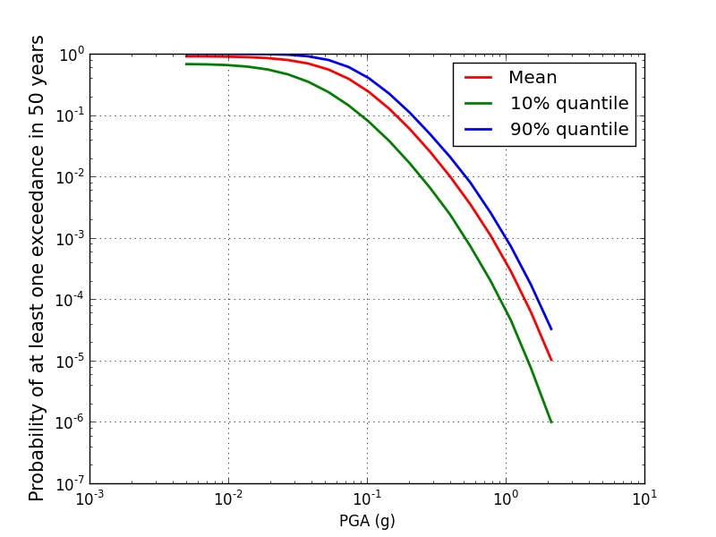
Logic-Tree Strategy – A Posteriori Statistic
From the ensemble of all hazard curves from each log-tree realization, mean and percentile curves can be computed
Note: Less data or knowledge should imply greater epistemic uncertainty
HOWEVER
Use of additional “conflicting” models (from newly available data) can increase epistemic uncertainty
Epistemic uncertainty might be (paradoxically) lower in regions with less data!

Slide 26
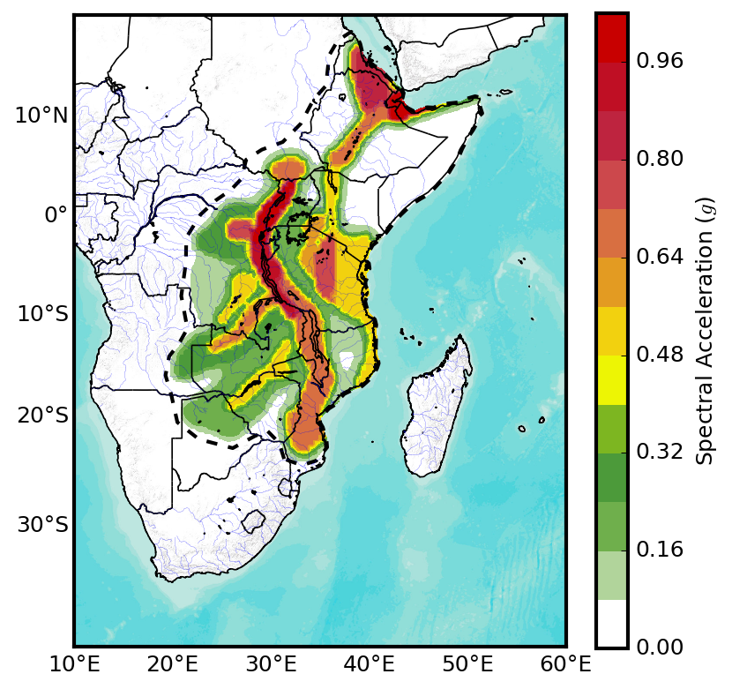
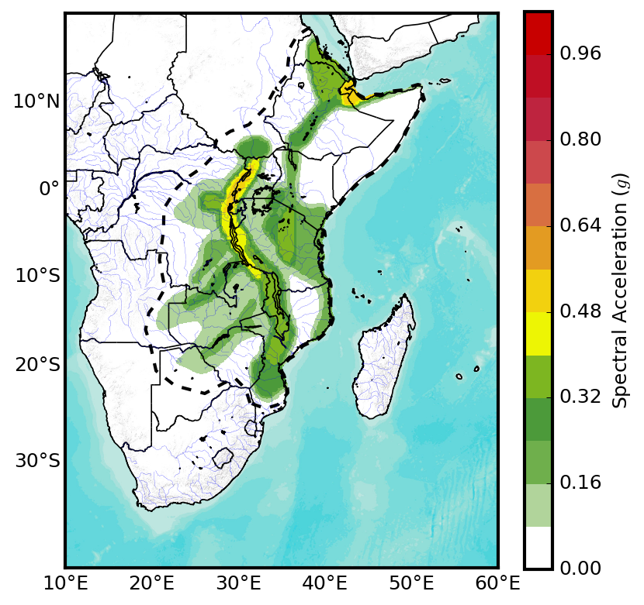
PSHA Outputs – Hazard Maps
Shows the uniform probability of exceedance of a given ground motion measure for a given return period
2% Probability in 50 years
10% Probability in 50 years
Spectral Acceleration @ 2 seconds

Slide 27
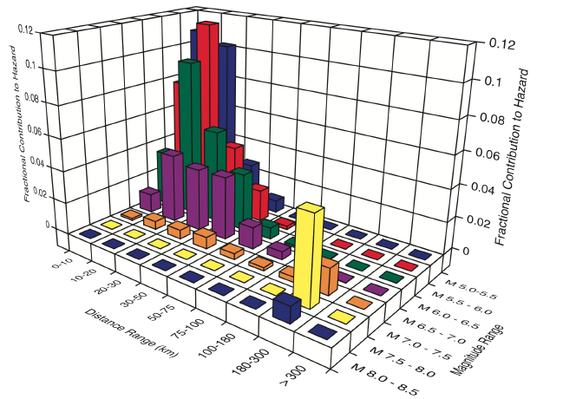
PSHA Outputs - Disaggreagation
For a given site, ground motion intensity measure and return period the fractional contribution of specific scenarios to the hazard can be extracted from the hazard analysis via disaggregation
Can identify scenarios that represent the greatest likelihood of contributing to the hazard

Slide 28

Thank you!
  Except where otherwise noted, this work is licensed under https://creativecommons.org/licenses/by-nc-nd/3.0/
  Please attribute to the GEM Foundation with a link to
  www.globalquakemodel.org

Slide 29
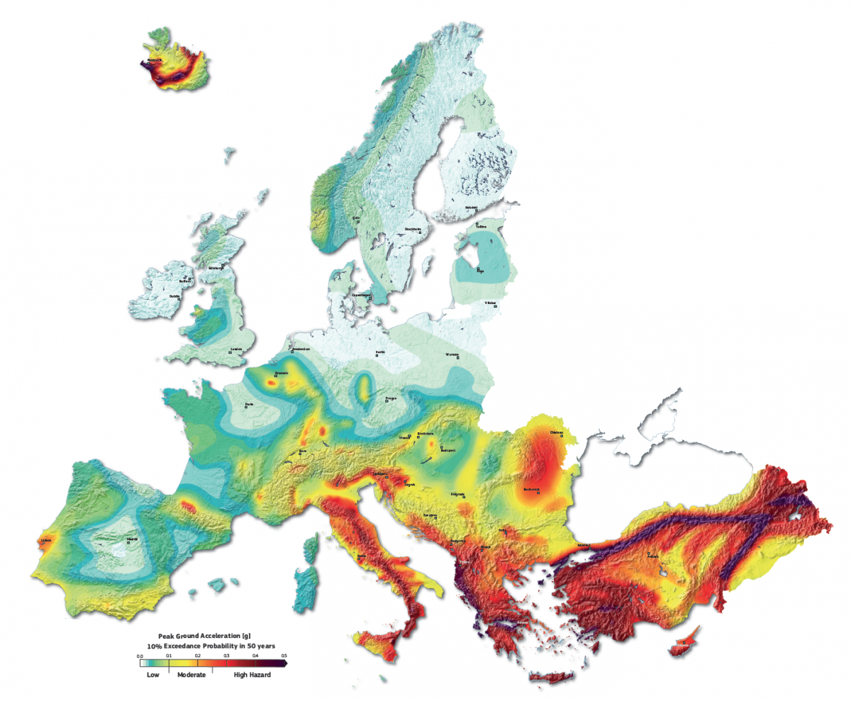

Slide 30
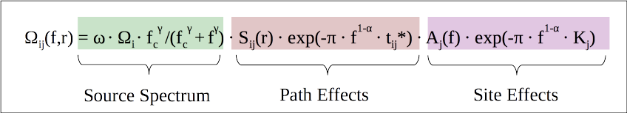
Ground Motion Prediction
The easiest way to model ground motion is perhaps the use of Ground Motion Prediction Equations (GMPEs)
GMPE terms are representations of a given physical model, whose reliability can be increased with the availability of new empirical information

Slide 31
Logic-Tree Strategy – Over Reliance?
The problem:
Less data/knowledge implies greater epistemic uncertainty
But if considering published (e.g. peer-reviewed) models, usually the case that more models will be available from regions with more data (e.g. more GMPEs for active shallow crust than for stable crust)
More use of more available models increases epistemic uncertainty in regions with more data, and therefore epistemic uncertainty is lower in regions with less data!
Need for a “minimum generic uncertainty” for regions with sparse data

